Slide 1
Database Application Development
Lecture 07 – Part 1
Week 08
DBS211

Slide 2
Application Architecture and Design
Web Services: Concepts, Architectures and Applications By Gustavo Alonso, Fabio Casati, Harumi Kuno, Vijay Machiraju. Chapter 1

Slide 3
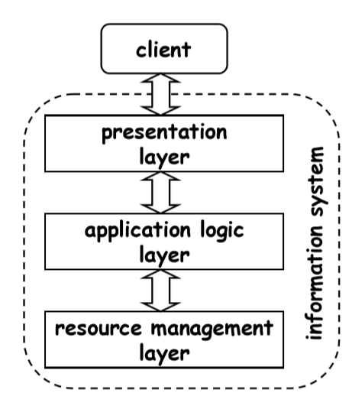
Application Layers
Applications are typically broken into three layers:
Presentation and user interface
Business (application) logic
Data access (resource management)

Slide 4
Presentation Layer
The presentation or the user interface provides the user interaction.
Different form of the presentation layers could be
Web browsers
Mobile phone user interface

Slide 5
Business Layer
The business or application logic layer provide the high level view and access of data.
In this layer, business rules are enforced.

Slide 6
Data Access Layer
The data access later is the interface between business layer and data resources. It deals with data storage and retrieval to support the business layer.

Slide 7
Application Design
Top-down Design
Bottom-up Design

Slide 8
Top-down Design
The functionality of the system is defined from the client’s point of view.
It determines how client interact with the system.
It focuses on high-level requirements.
Advantages:
It focuses on final goals.
It addresses
Functional issues – the operations that are supported
Non-functional issues – the performance and availability
Disadvantages
The system has to be entirely developed from scratch.

Slide 9
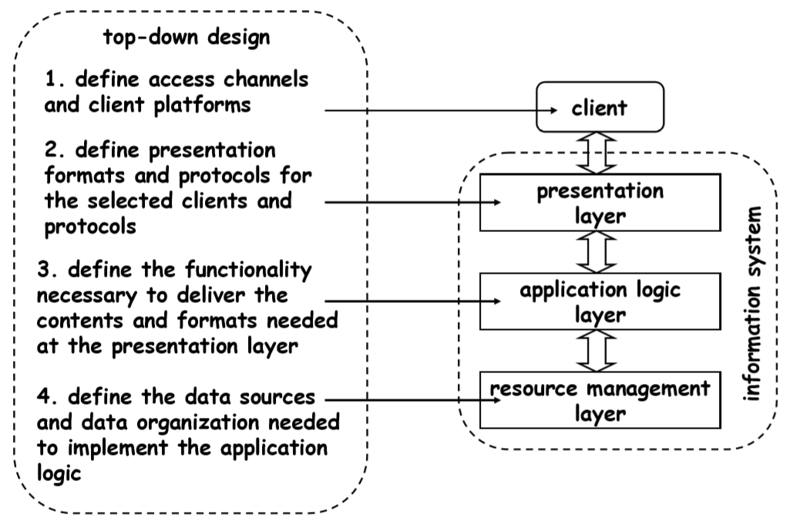
Top-down Design

Slide 10
Bottom-up Design
The system components and parts are designed.
The smaller parts and components of the system are then combined to achieve a higher goal.
New systems can be created by integrating existing systems.
The bottom-up approach includes:
Investigating existing applications and processes
Analyzing the problem domains
Redefining and reconstructing the problems
Determining the high-level objectives achieved by integrating these applications

Slide 11
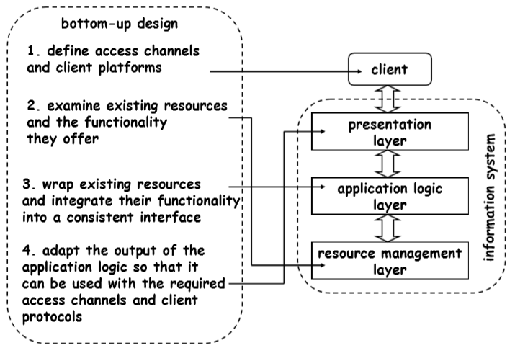
Bottom-up Design

Slide 12
Application Architecture
Two-tier architecture
Three-tier architecture

Slide 13
2 Tiered Architecture
The two-tier application is based on client server approch.
There is a direct communication between client and server.
Client request data from server. Further data processing can be done on the client side.
The two-tier architecture has two main parts:
Database
Client application
Advantages:
Since there is not any intermediate layer between client and server, two-tier application runs faster. Business and data managements are in one layer.
Disadvantages:
It supports limited number of clients.
The server cannot respond multiple request same time

Slide 14
3 Tiered Architecture
In this architecture, there is an intermediate layer between presentation (user interface) and data layers.
Three separate layers:
Presentation
In this layer, the users send requests and receive data.
Business/application logic
In this layer, business rules are applied on
data calculation
data validation
data input
Data
This layer includes methods to
connect to the data resource (database)
manipulate data such as insertion, deletion, and modification

Slide 15
Database Application Development
A First Course in Database Systems_3rd Edition
https://dev.mysql.com/doc/connector-cpp/8.0/en/Oracle document
MySQL Document

Slide 16
Three Tiered Architecture
It has three interactive parts:
Web Server
includes components that connect clients to the database systems.
Application Server
performs the business logic.
Database Server
This component runs the database and performs the queries requested from the application server.

Slide 17
Database Application
How SQL fits into a programming environment?
How a typical application can access a database to fetch or manipulate data in a database?
How to embed SQL to programs with programming languages such as C++?

Slide 18
Database Access from Application
How SQL commands can be executed in a host language?
Embedded SQL
Cursors
Dynamic SQL

Slide 19
Embedded SQL
SQL statements and commands can be used in the host language. In this course, we use C++ as the host language.
In an Embedded SQL approach, the host language can consist of either static or dynamic SQL or a combination of both.
One approaches to embed SQL statements in a host language:
Call Level Interface (CLI):
In this approach, a program uses some libraries to access the database. All SQL statements are set of strings that are passed to the database using a CLI function call.

Slide 20
SQL Application
Connect to DBMS
Retrieve data from the database
Manipulate data
Modify data in the database

